Slide 1

CREATE YOUR AWS ACCOUNT
In this module, we will create our root AWS account

Slide 2
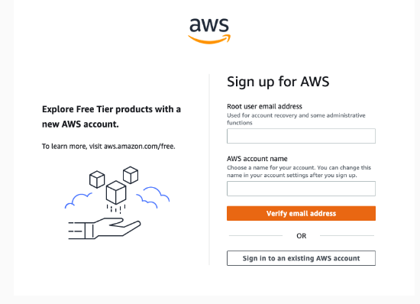
SELECT EMAIL, ACCOUNT NAME, AND PASSWORD

Slide 3
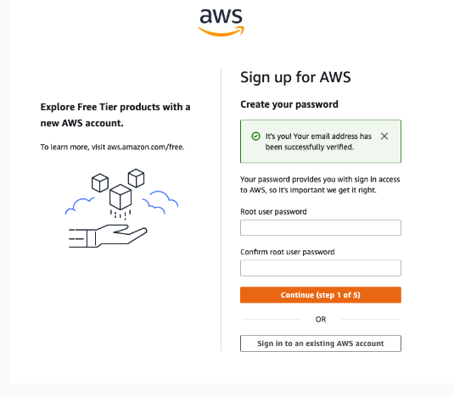
PASSWORD:

Slide 4
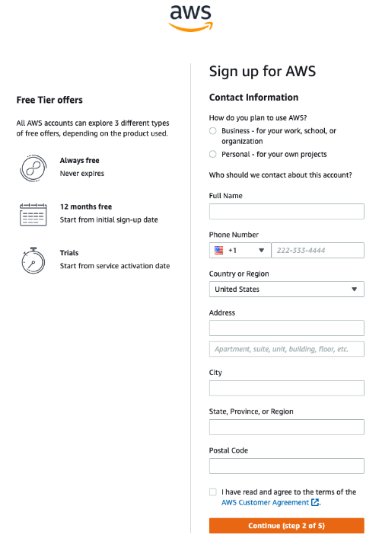
ADD CONTACT INFORMATION:

Slide 5
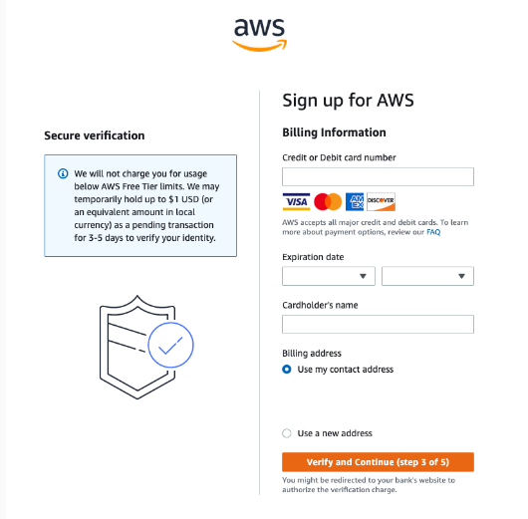
Add a payment method

Slide 6
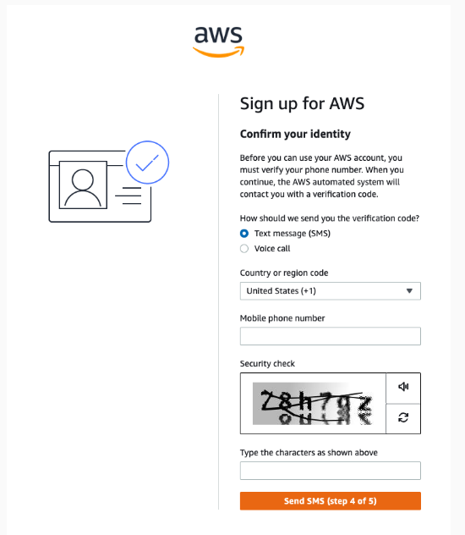
Confirm your identity

Slide 7
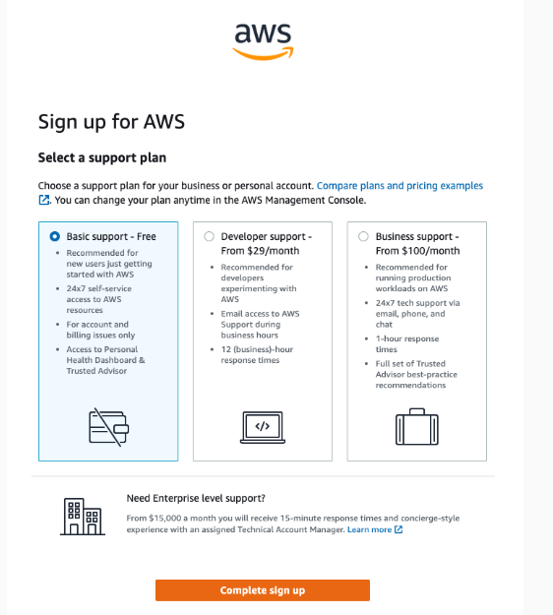
Select a support plan

